Slide 1
Predicting the severity of road collisions in Seattle.
by Gibrán Mendoza Magaña

Slide 2
Predicting collisions and its degree of severity can:
Save lifes as drivers can be deterred from taking a certain road in favor of a safer route.
Help emergency services decide how to prioritize their responses.
Help city and transportation planners update regulations in sake of general safety.
Help save millions of dollars due to property damage, injury related loss of productivity, healthcare expenses etc.
Prevent the loss of thousands of lives every year.

Slide 3
Data acquisition and cleaning
Data was obtained directly from the City of Seattle Open Data portal.
Data obtained consists of:
Collisions from January 2004 to mid-September 2020. https://data.seattle.gov/dataset/Collisions/nuam-5pkc
Parameters of Seattle’s streets including width, type of pavement, type of artery, zone, etc. https://data.seattle.gov/dataset/Seattle-Streets/b856-55i2
Data was transformed from categorical to numerical data.
After data cleaning 166,325 observations of 51 parameteres were used to train the model.

Slide 4
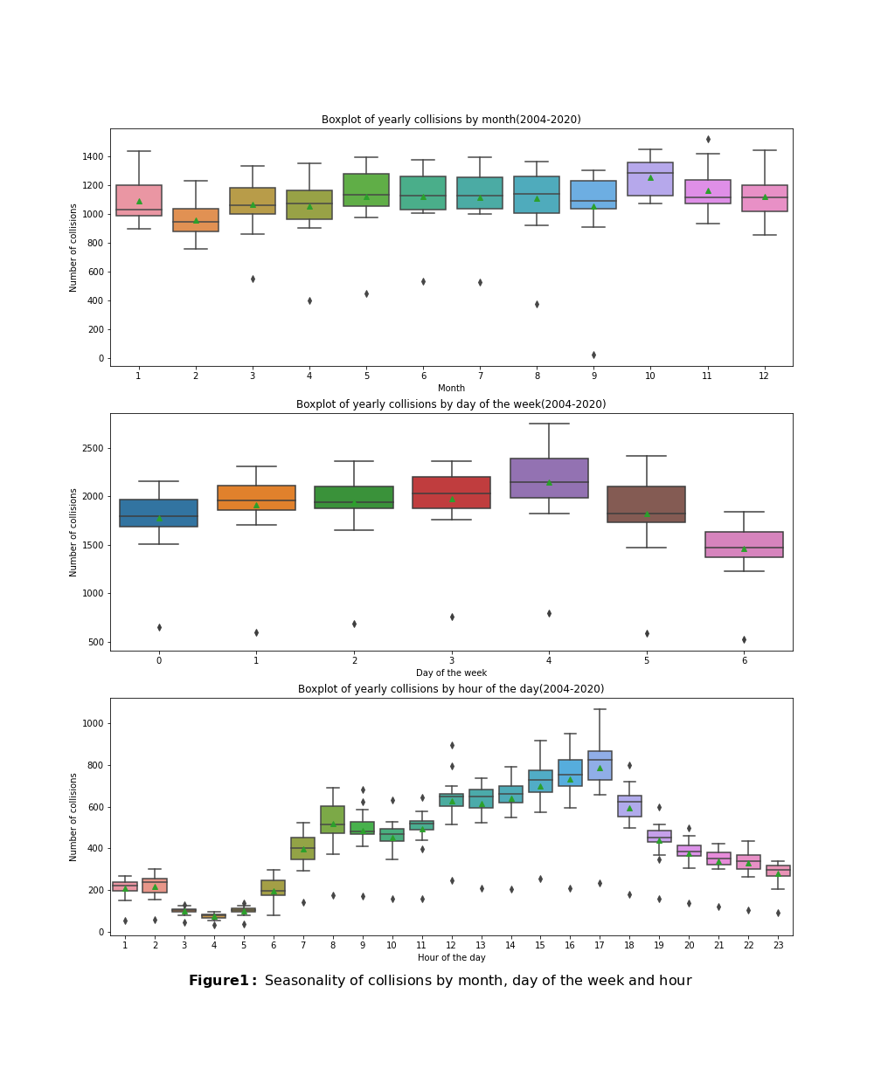
Seasonality
Traffic collisions have a seasonal behavior where:
On average, daily collisions have a global peak at 17 hours and a local peak at 8 a.m. Consistent with commuting times. Collisions are minimal at 4. a.m.
On average, weekly collisions are minimal on Sundays and reach their max on Fridays, consistent with the amount of traffic during the week.
On average, October seems to be the month with more collisions, this could be due to a combination of rain + amount of traffic on the streets (more traffic than in winter).

Slide 5
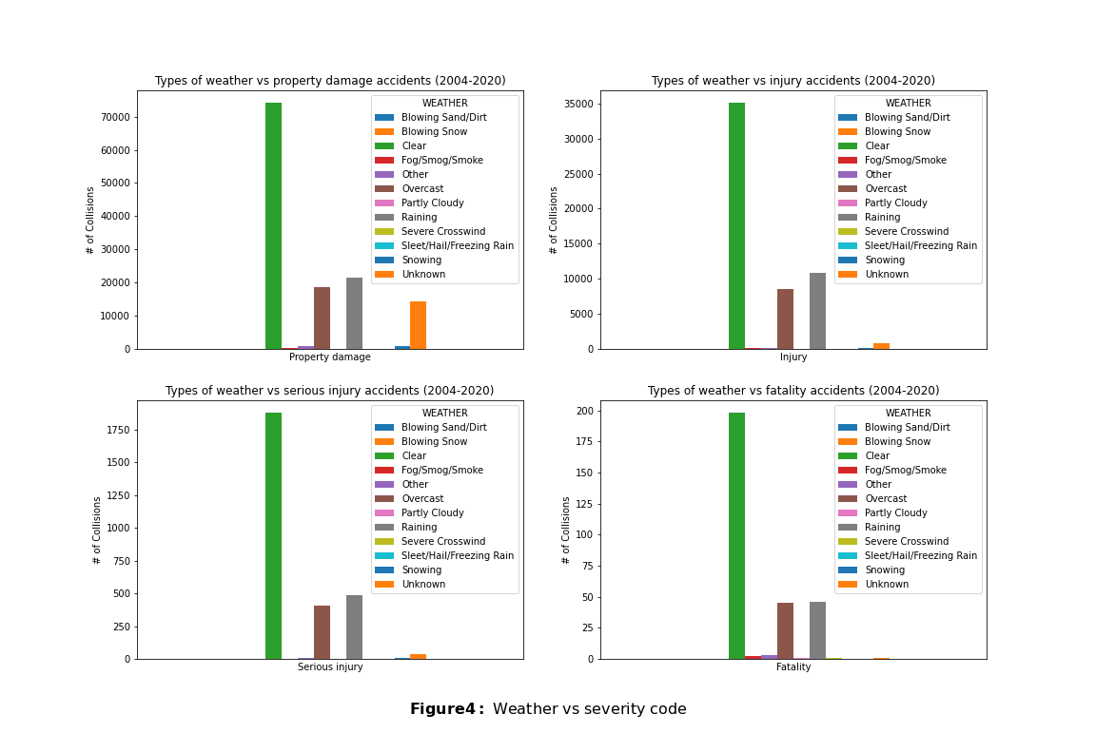
Weather
Most accidents take place with clear skies.
Second and third place are taken by Rain and Overcast, respectively, but they are outnumbered with respect to “clear” weather.
Blowing Snow only increases property damage type of collisions.

Slide 6
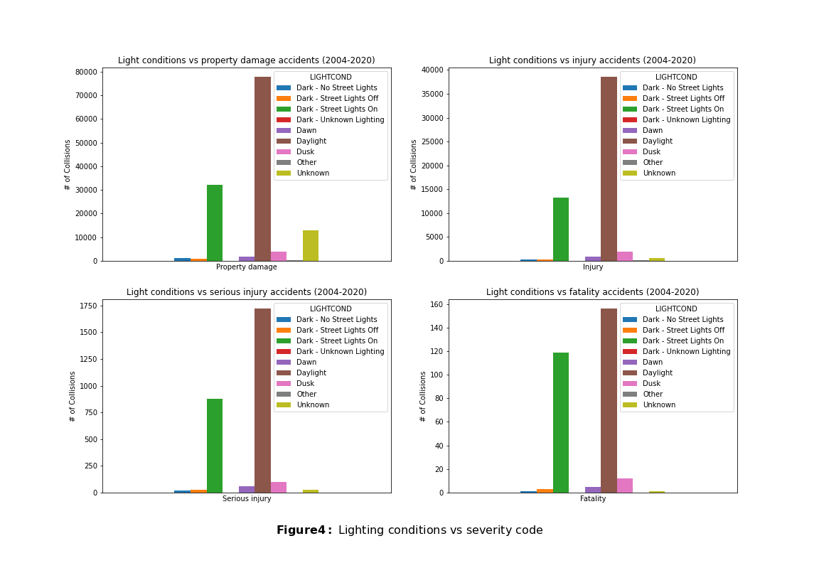
Light
Most accidents take place during daytime, consistent with what was shown in slide 4.
The proportion of fatal collisions are almost 50-50 between daytime and nighttime.

Slide 7
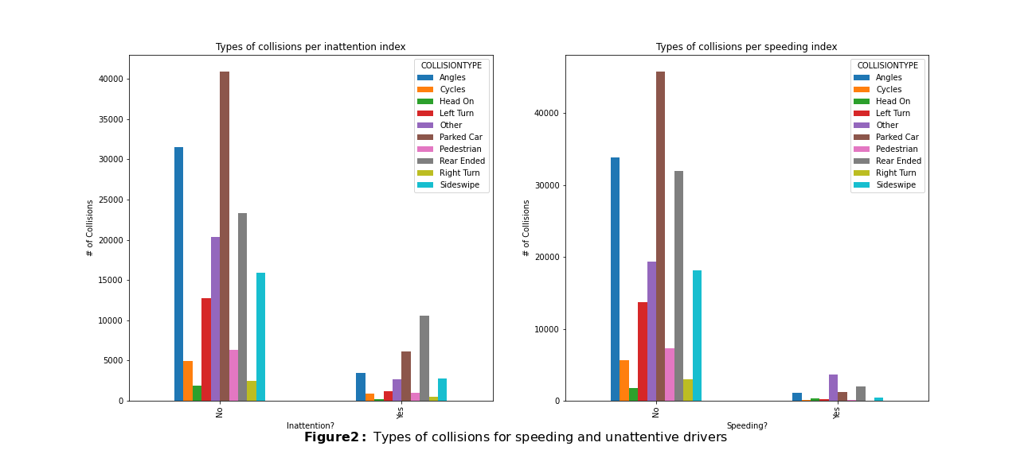
Carelessness
Inattentive drivers are more likely to hit the back of the car in front of them…or a parked car...
Speeding can cause “other” type of collisions different than the typical ones….turning upside down?

Slide 8
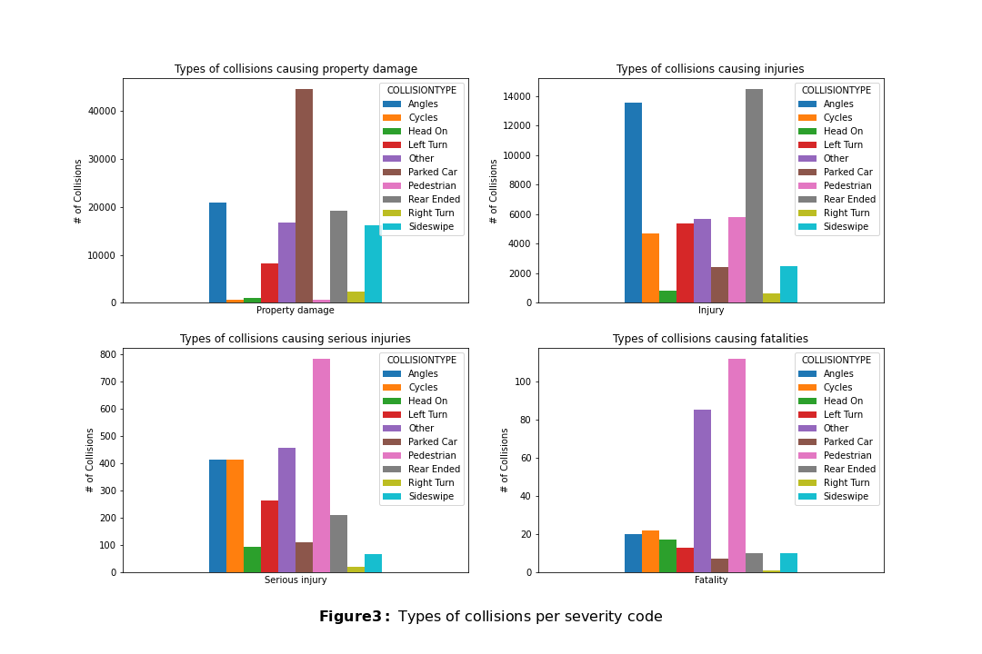
Actors and actions
The most vulnerable traffic actors are pedestrians and cyclist.
Rear ended collisions cause mainly non-serious injuries. Head-on collisions are more fatal.
Crashing at angles and during left turning can produce any type of collision.

Slide 9
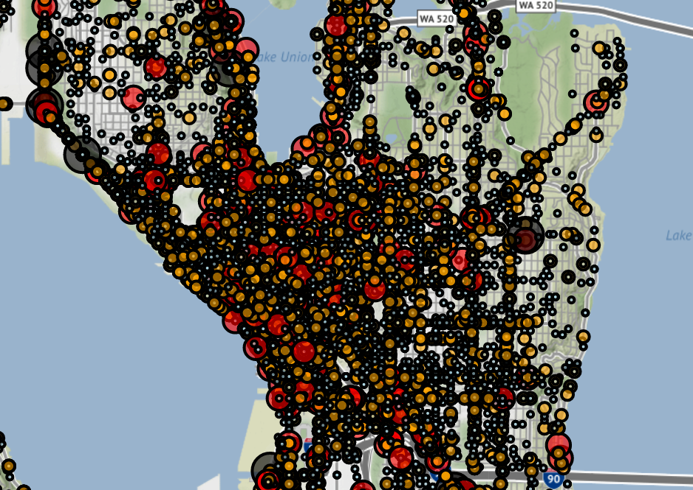
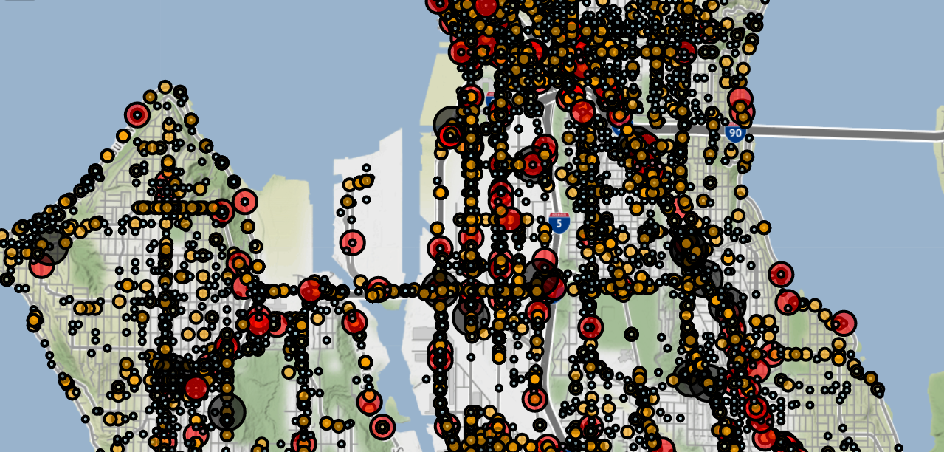
Location
Collisions are more present in Downtown Seattle and along Seattle’s principal arteries.

Slide 10
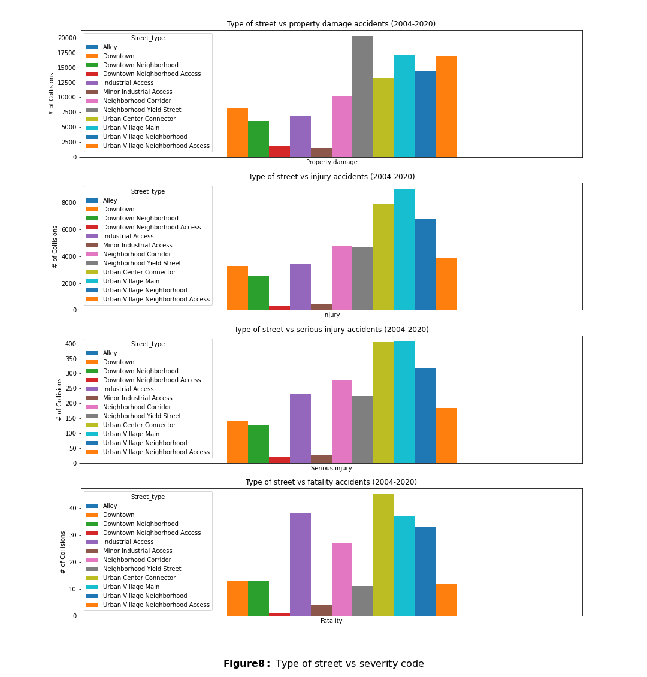
Types of streets
Industrial and Urban roads with high-speed limits have more severe collisions.
Downtown streets have all degrees of severity of collisions.
Neighborhood streets with lower speed limits have less severe accidents.

Slide 11
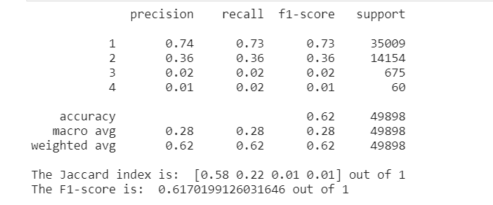
Decision trees: Unbalanced
Decision trees: SMOTE
VS

Slide 12
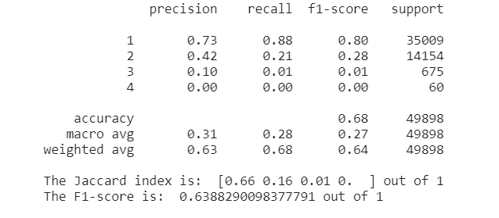
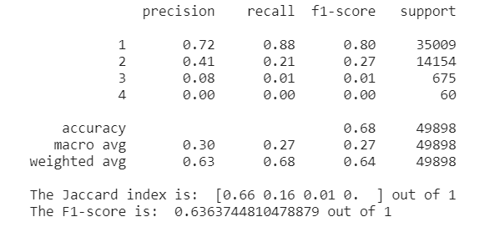
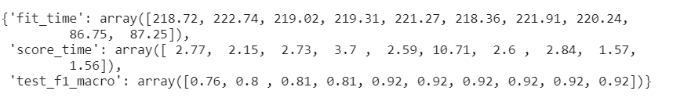

Random Forest: Over sampling
Random Forest: Over + Under sampling
VS

Slide 13
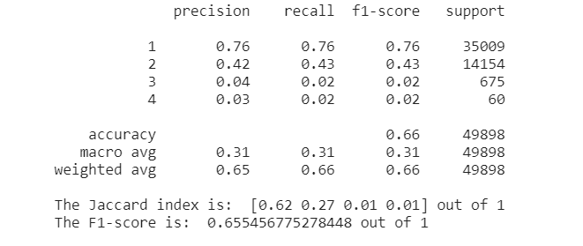
Random Forest Hyperparameters:
Criterion: ‘gini’
Max_depth: 15
Max_features: 8
N_estimators: 700

Slide 14
Discussion
A mix of under sampling and oversampling provides better result for training the model.
Random Forest Classifier performs better for unbalanced data than Decision Trees.
Model performs better than randomness for predicting severity types 1 and 2 but cannot predict severity accidents type 3 and 4.

Slide 15
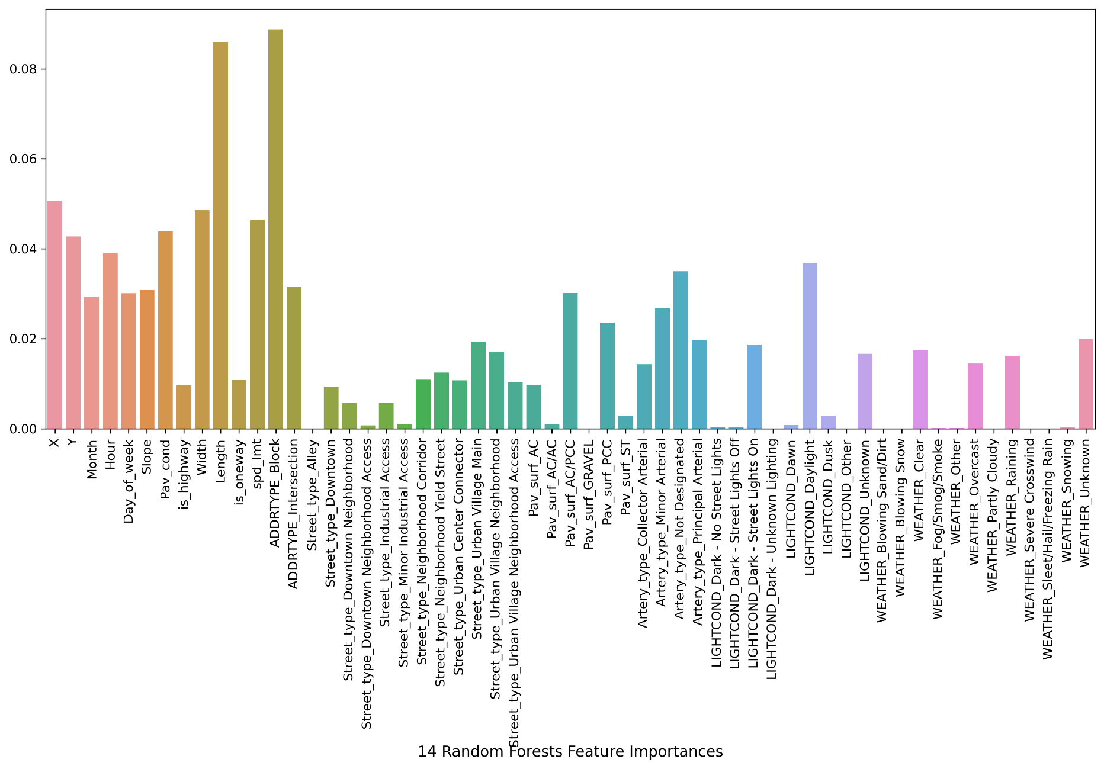
Results
Among the most important factors to determine the severity of a collision are:
Whether if accident occurs in a block or an intersection
Length of the street
Width of the street
Speed limit
Coordinates
Artery type
Hour and day of the week
Weather and light conditions
Street type

